Slide 1

Down Data Analyst
Home Assignment
Irwan Mulyawan
Private & Confidential

Slide 2


Agenda
1
Summary
One Metric That Matters
Exploratory Data Analysis
Question to be Answered
Conclusion & Suggestion
2
3
4
5

Slide 3
1. Summary
The daily trend shows a positive trend in August, which is always increasing linearly from the 1st to the 15th, but after that it show a decline until the end of the month, we can solve this by refining the filter type with firstly comparing the number of clicks with the number of search results to evaluate the performance of the Filter Type feature.
Due to high disparity exposure between male and female users more than 600 times, we need to adjust the algorithm so that male users also have the same exposure opportunity as female.
With 2 million exposures for filter ‘nearby’, we can suggest to Engineering team to evaluate and improve the GPS algorithm to ensure that the nearby feature remains reliable.
For Marketing Team we can suggest to conduct special campaigns or discounts on premium services for users who activate the 3some feature, due to almost 250k exposures for 3some feature.
Need to evaluate the criteria for users flagged as Bad Actors, because it turns out that Bad Actors do not affect to exposure numbers.

Slide 4
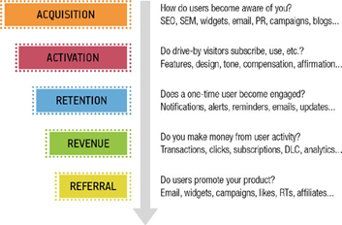
2. One Metric that Matters
In the context of this analysis, the one metric that matters that I recommend is the Median Exposures per New User, assuming the company is in the activation stage
Source: Lean Analytics - Use Data to Build a Better Startup Faster

Slide 5
2. 1. OMTM Metrics
Median Exposures per New User
Definition:
The median number of exposures each new user gets.
Business Value:
This helps in understanding the general visibility new users are receiving. If some new users have significantly fewer exposures compared to others, it may indicate issues with how they are being presented.

Slide 6
2. 2. Supporting Metrics
1. Definition:
The total number of times new users’ profiles have been viewed by others. This metric will focus on profiles created recently, which we’ll classify as "new users."
Business Value:
It measures how visible new users are within the app, helping us understand if our platform effectively exposes new members to others. High exposure indicates good integration of new users into the ecosystem.
2. Definition:
The distribution of new user exposures segmented by the filter type used during profile viewing.
Business Value:
It provides insights into which filters are leading to more exposures for new users. This helps product teams optimize the filters to maximize exposure, guiding decisions on default filter settings or improvements.
1
Total Exposure Count
Exposure Number by Filter Type
2

Slide 7
2. 2. Supporting Metrics
3. Definition:
The distribution of new user exposures by gender, showing how many times male vs. female new users' profiles are being viewed.
Business Value:
It helps determine whether there is any bias in exposure based on gender, which can be crucial for ensuring that all users have an equal chance of being seen.
4. Definition:
The impact of bad actors on new user exposure by analyzing the difference in exposure between interactions involving banned users and those involving genuine users.
Business Value:
It provides insights into whether banned users (bad actors) are disproportionately affecting the experience of new users. This can lead to adjustments in content moderation policies or algorithms to prioritize genuine interactions.
3
Exposure Distribution by Gender
Impact of Bad Actors on Exposure
4

Slide 8
2. 2. Supporting Metrics (Need more data provided)
5. Definition:
The percentage of exposures that result in a "like" from the viewing user. Although we don't have explicit "like" data in the provided datasets, we could approximate this metric if we had data indicating which views resulted in further interaction.
Business Value:
Measures how effective new user profiles are at engaging viewers. This helps to identify if certain types of profiles or segments of new users are more appealing, leading to higher conversion rates.
5
New User Exposure Conversion Rate

Slide 9
3. Exploratory Data Analysis
Overview Exposures
Exposure Distribution
Dashboard Link
1
2
3

Slide 10
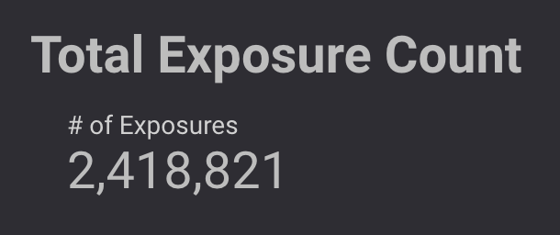
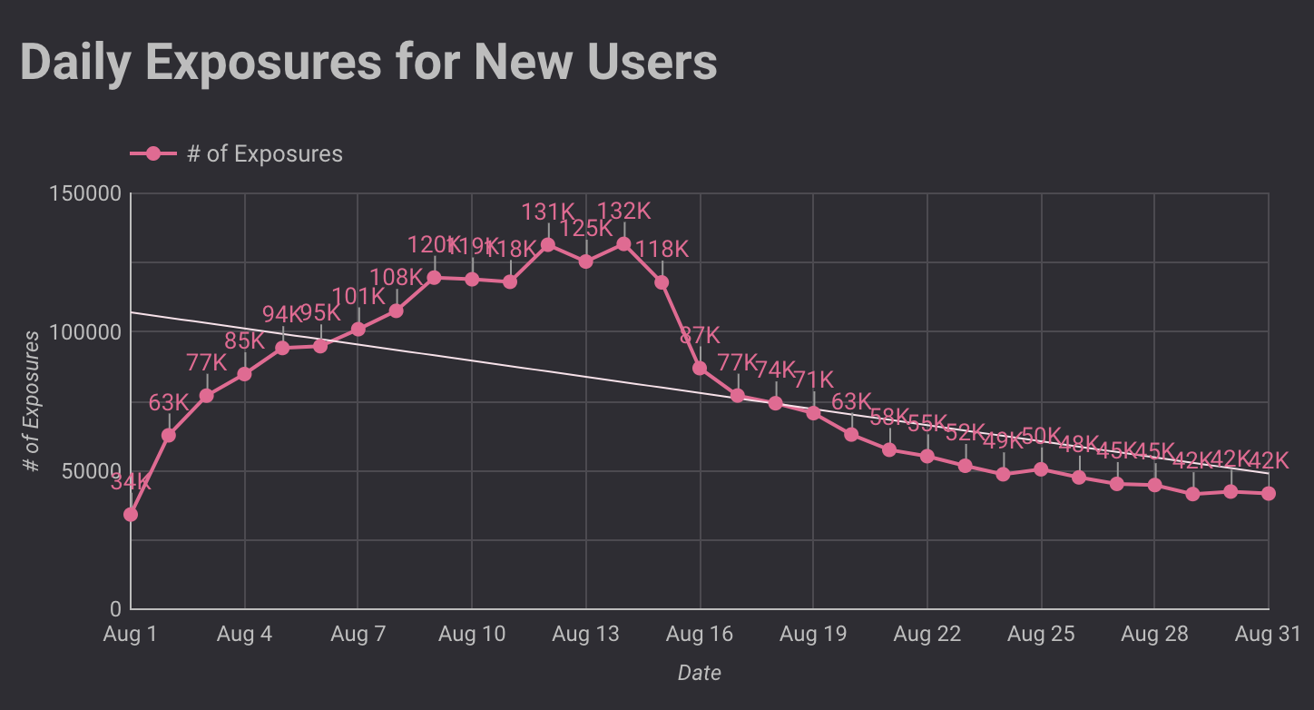
3. 1. Overview Exposures
Insight & Analysis:
We have quite a large exposure to new users in August, which is around 2.4 million exposures.
The daily trend also shows a positive trend, which is always increasing linearly from the 1st to the 15th, but after that it needs to be awareness because the data trend continues to show a decline until the end of the month
We need to digest more what happened on the 15th and after.

Slide 11
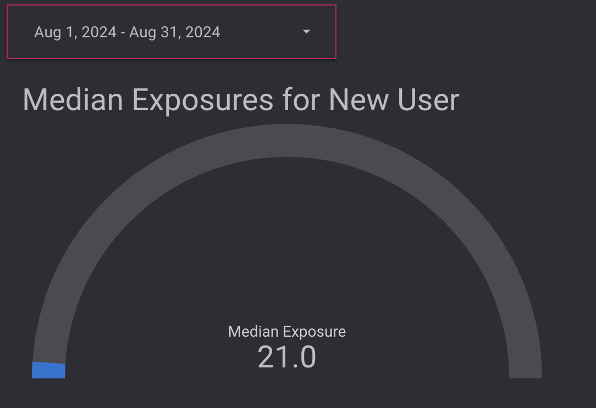
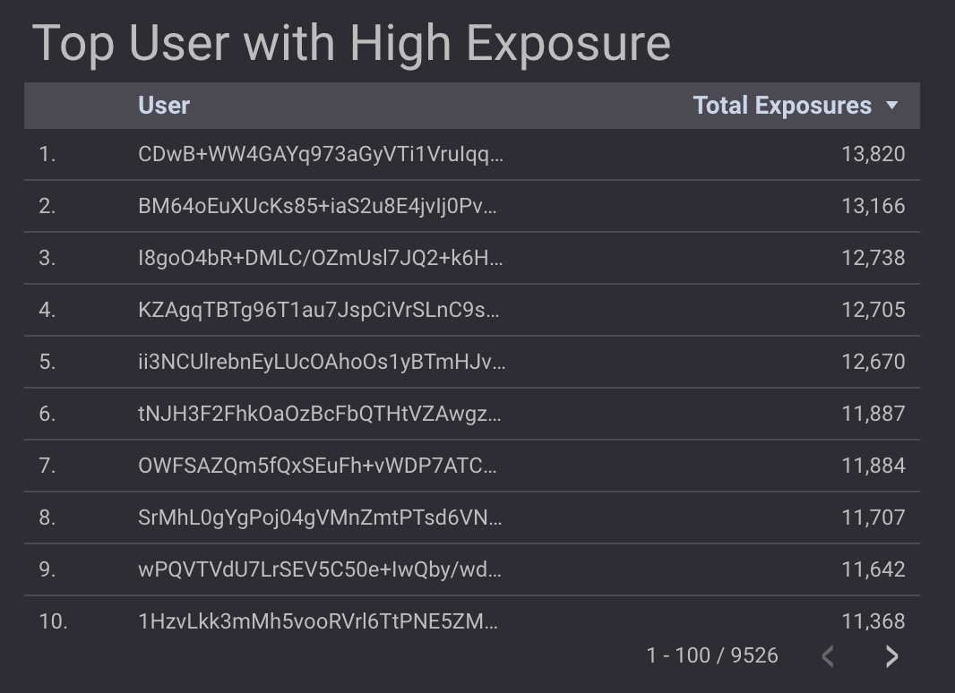
3. 2. Exposure Distribution
Insight & Analysis:
By displaying the top 10 new users with the highest exposure, we can see that top tier users have exposure more than 10,000 exposures per user
This is in contrast to the median exposure of new users which is only around 21 exposures which 658 times.
It can be concluded that there is a high disparity between regular new users and top tier new users
We need to develop strategies or change the algorithm to expose more regular users as well as to increase the number of top tier users from regular users.

Slide 12
3. 3. Dashboard Link
https://lookerstudio.google.com/u/0/reporting/f2215d42-aae2-494e-943f-273bfc7ee095/page/TbFEE
This dashboard will display data in real time and can be customized with a certain period.
The data has been automatically connected with the raw spreadsheet data

Slide 13
4. Question to be Answered
Cohort Analysis
User Segmentation
Filter Type that impacted to User Exposure
Bad Actors Impact Analysis
1
2
3
4

Slide 14
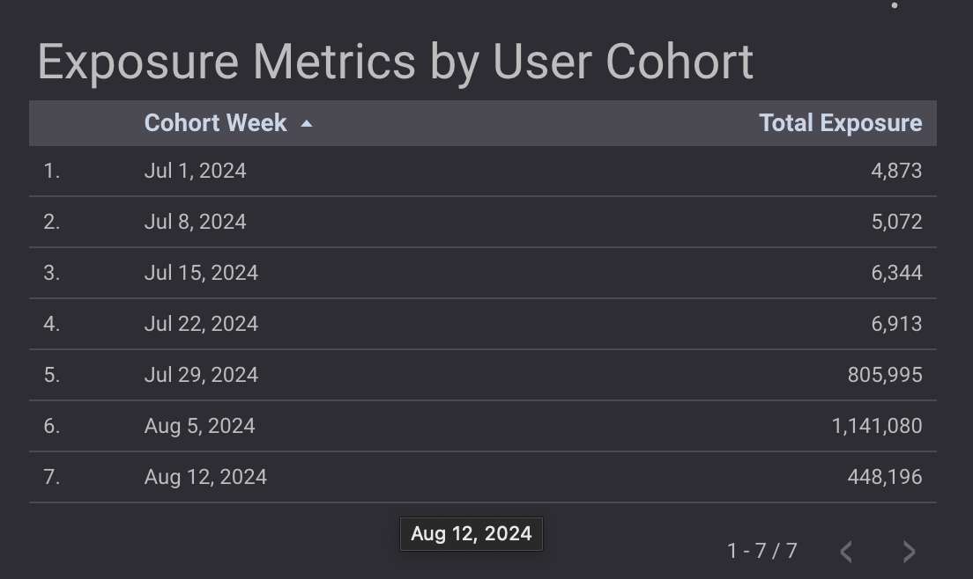
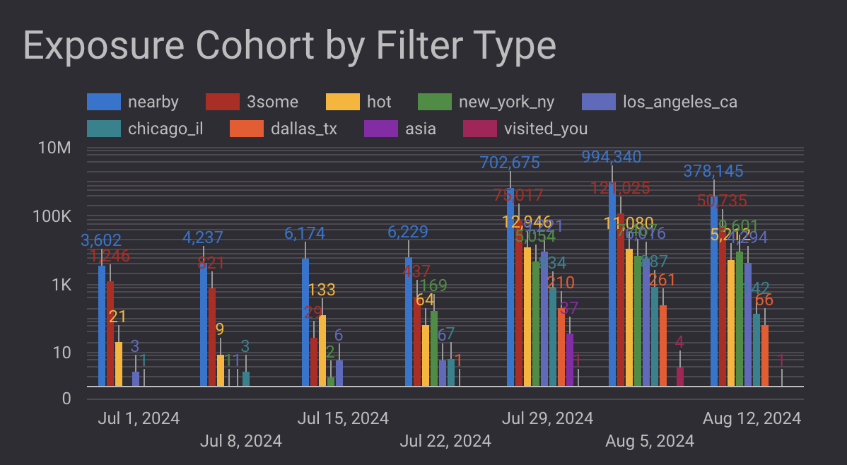
4. 1. Cohort Analysis
Insight & Analysis:
The interesting thing is that the cohort has a similar trend to the exposure overview, where the cohort data always increases from week to week, but experiences a decline in the middle of August.
When we break down per Filter Type, one of the reasons is caused by being the decrease in exposure of the 'nearby' filter type from almost 1 million exposures to 378k exposures or a 62% decrease and '3some' filter type from 121k exposures to 50k exposures or a 58% decrease.
Key Insight:
Filter not perform well after week 2 August

Slide 15
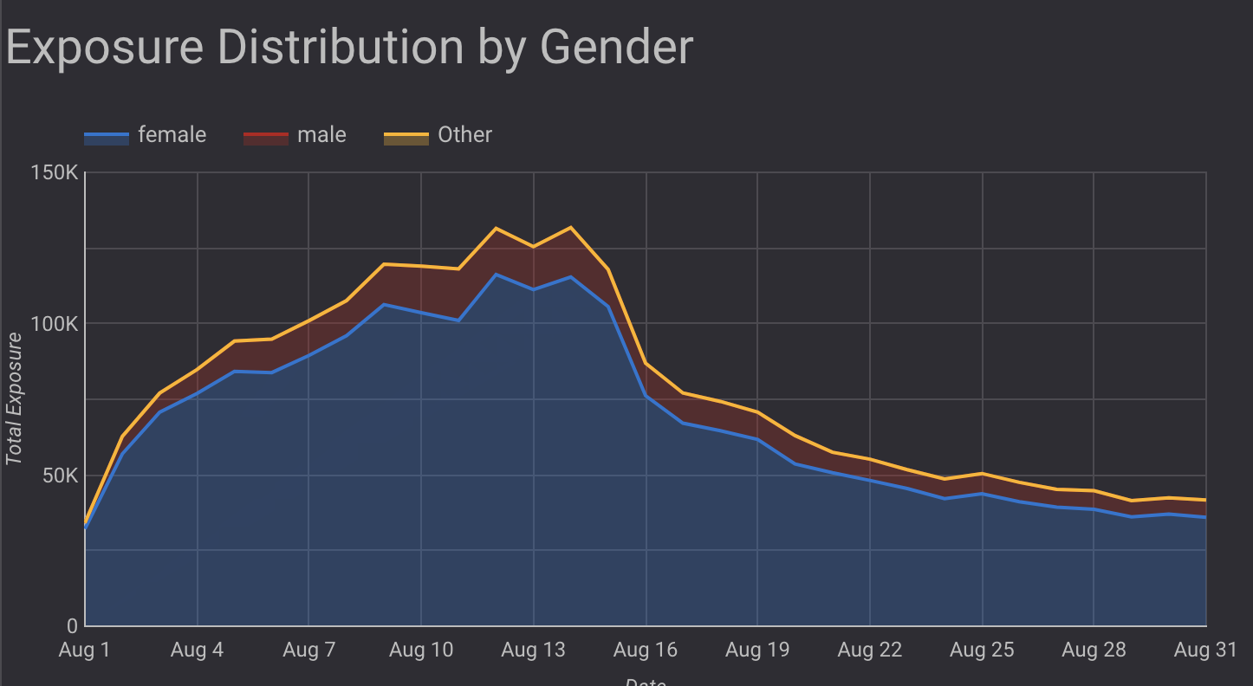
4. 2. User Segmentation
Insight & Analysis:
We can see that females dominate Exposure from day to day.
This is in accordance with the previous analysis that there is a very large disparity between new users.
We need to change the algorithm so that males can also be exposed more to increase the possibility of match numbers.
Because, if we only have top tier users from one gender, then for heterosexuals it will reduce the conversion rate match.
Key Insight:
Female exposure > Male Exposure; Need to change the algorithm

Slide 16
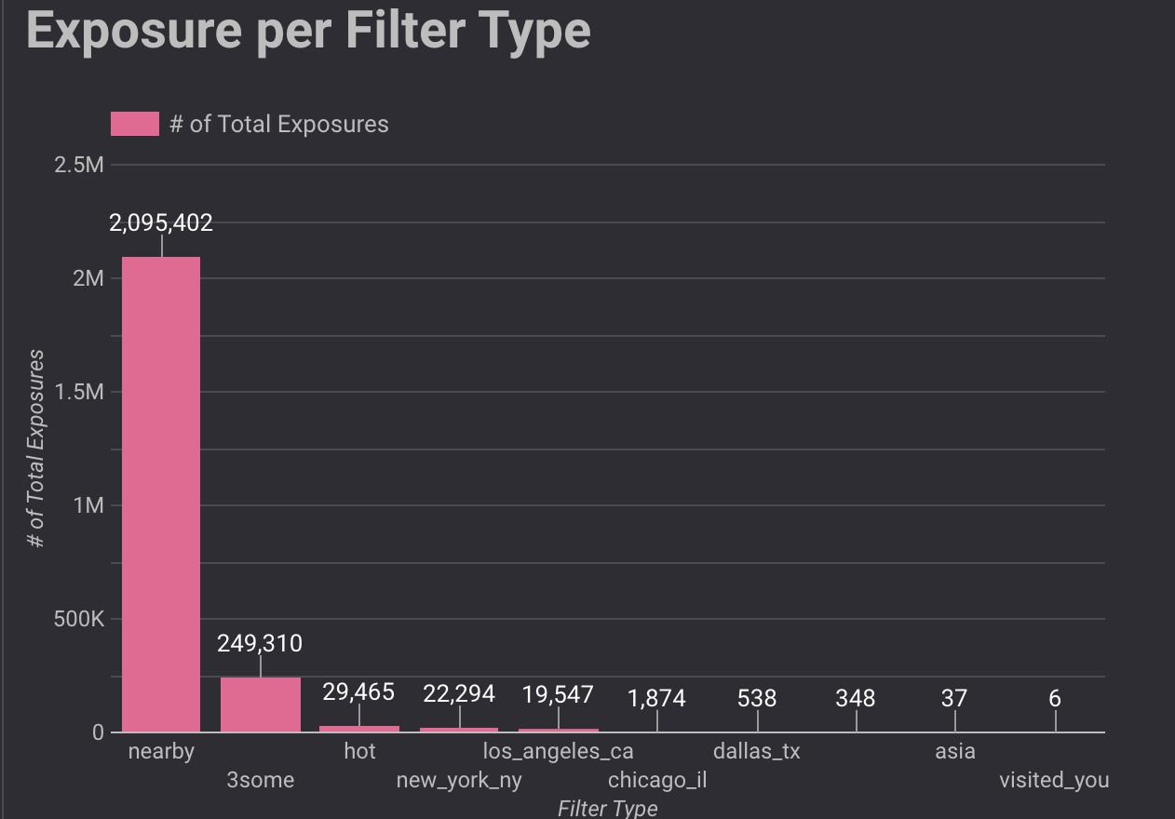
4. 3. Filter Type for User Exposure
Insight & Analysis:
The top filter is the "nearby" filter around 2 million exposures, which makes sense as users will look for people close to their location to make it easier to meet.
However, the interesting thing is the second largest filter, which is 3some almost 250k exposures. This needs to be taken into consideration as many new users get exposure to other users who are interested in threesome.
Key Insight: Nearby and threesome feature as a feature we can focus on

Slide 17
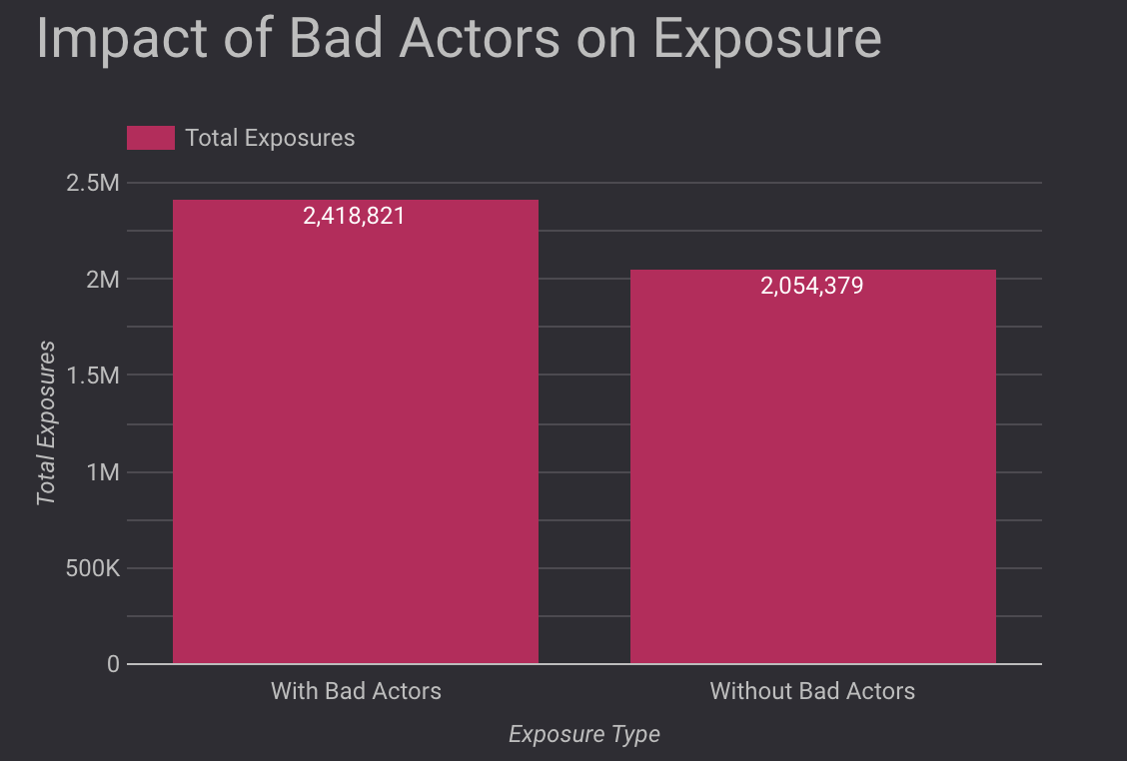
4. 4. Bad Actors Impact Analysis
Insight & Analysis:
The interesting thing here is that Bad Actors can actually increase exposure by 17.7%
This means that Bad Actors do not have a significant impact on exposure.
Suggestion:
There needs to be more information on what are the criteria for users to be called Bad Actors
Key Insights: Bad Actors not influence on Exposure; need to evaluate Bad Actors criteria

Slide 18
5. Conclusion & Suggestion
Conclusion:
The daily trend shows a decrease in exposure after the 15th, this is caused by one of the reasons is the Filter Type number exposure which decreased
There is a high disparity between top tier new users and median users which 658 times, this is due to the large difference in exposure between female and male user.
The nearby and 3some features are the features with the highest exposure compared to other features with more than 2 million exposure and almost 250k exposure.
It turns out that Bad Actors do not affect exposure, instead increasing the amount of exposure.
Suggestion
We can refining the filter type by first comparing the number of clicks with the number of search results to evaluate the performance of the Filter Type feature.
We need to adjust the algorithm so that male users also have the same exposure opportunity.
For technical team, we can suggest to evaluate and improve the GPS algorithm to ensure that the nearby feature remains reliable. For marketing team, we can suggest to conduct special campaigns or discounts on premium services for users who activate the 3some feature.
Need to evaluate the criteria for users flagged as Bad Actors.

Slide 19
THANK YOU

